Slide 1
主的复活与我们的受浸
黄力夫弟兄

Slide 2
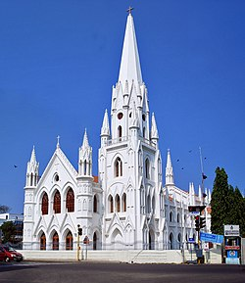
耶稣的复活 Resurrection of Jesus
多人看见。Many had witnessed.
门徒生命的改变。Life change for the Apostles.
多马。Thomas.

Slide 3
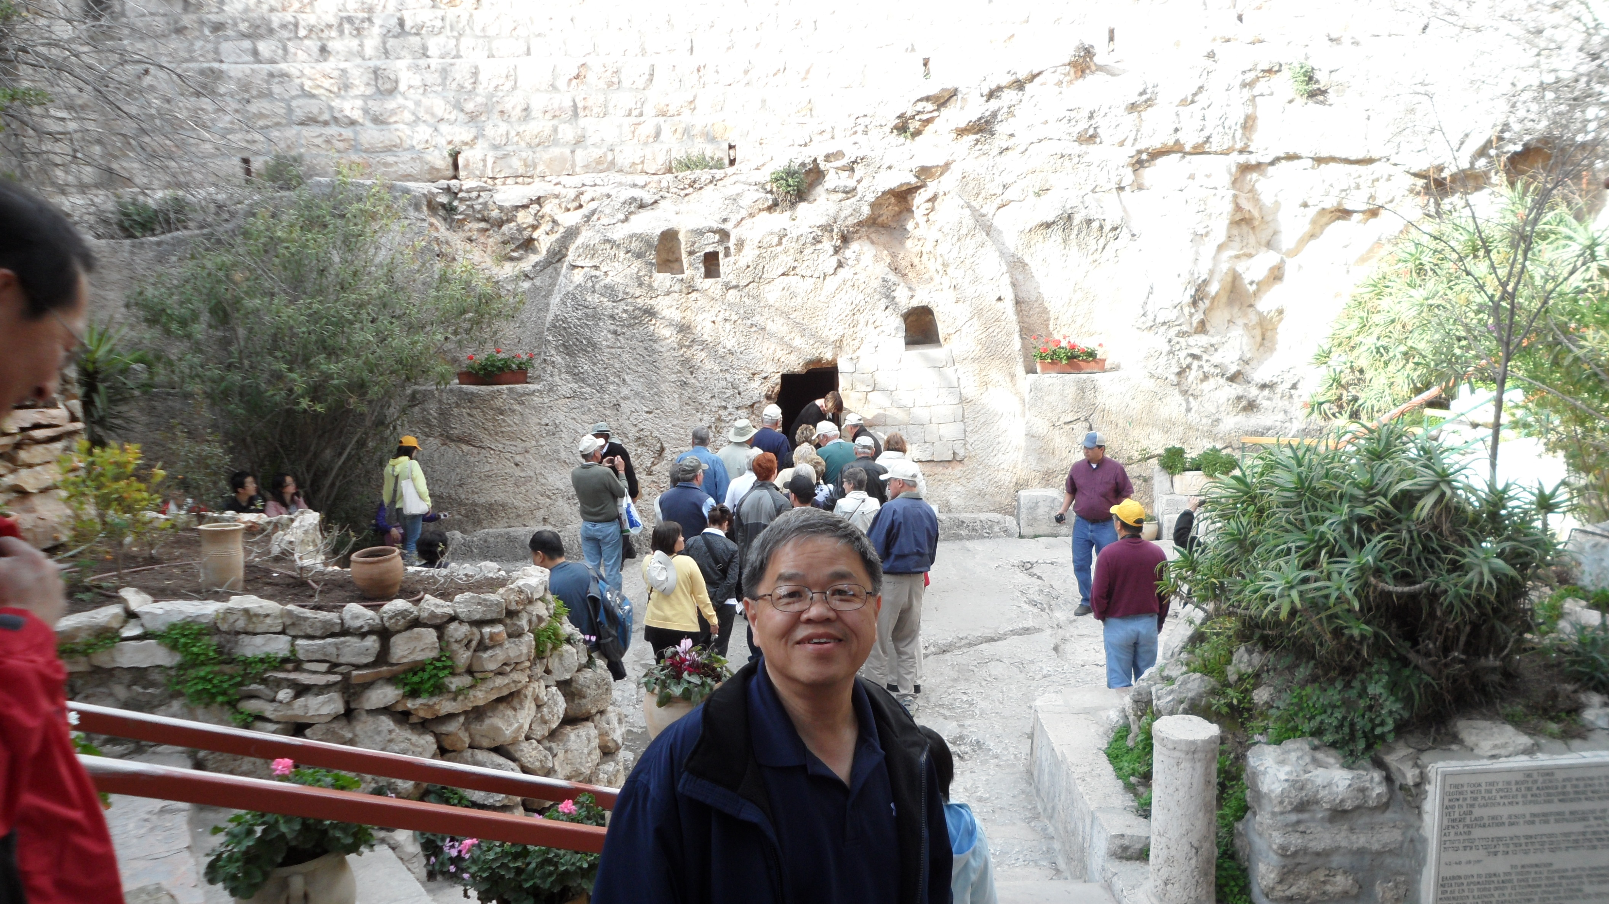

Slide 4
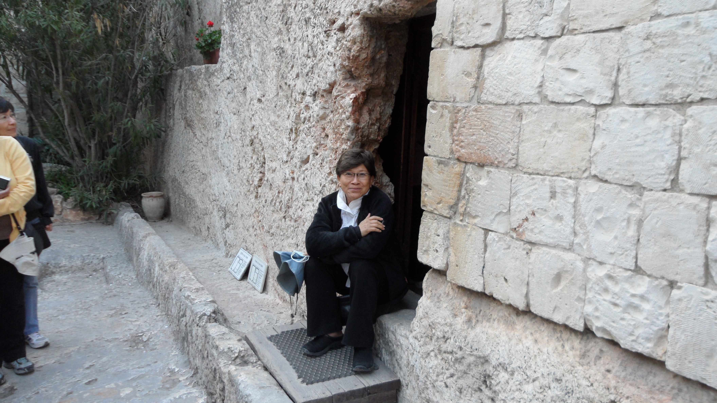

Slide 5
罗马书 Romans 6：3-11
岂不知我们这受洗归入基督耶稣的人是受洗归入他的死吗？
Or don’t you know that all of us who were baptized into Christ Jesus were baptized into his death?

Slide 6
所以，我们藉著洗礼归入死，和他一同埋葬，原是叫我们一举一动有新生的样式，像基督藉著父的荣耀从死里复活一样。
We were therefore buried with him through baptism into death in order that, just as Christ was raised from the dead through the glory of the Father, we too may live a new life.

Slide 7
我们若在他死的形状上与他联合，也要在他复活的形状上与他联合；
If we have been united with him like this in his death, we will certainly also be united with him in his resurrection.

Slide 8
因为知道我们的旧人和他同钉十字架，使罪身灭绝，叫我们不再作罪的奴仆；
For we know that our old self was crucified with him so that the body of sin might be done away with, that we should no longer be slaves to sin--

Slide 9
因为已死的人是脱离了罪。
because anyone who has died has been freed from sin.
我们若是与基督同死，就信必与他同活。
Now if we died with Christ, we believe that we will also live with him.

Slide 10
因为知道基督既从死里复活，就不再死，死也不再作他的主了。
For we know that since Christ was raised from the dead, he cannot die again; death no longer has mastery over him.

Slide 11
他死是向罪死了，只有一次；他活是向神活著。
The death he died, he died to sin once for all; but the life he lives, he lives to God.

Slide 12
这样，你们向罪也当看自己是死的；向神在基督耶稣里，却当看自己是活的。
In the same way, count yourselves dead to sin but alive to God in Christ Jesus.

Slide 13
受洗归入基督的死
Baptized into The Death of Christ
基督的死：基督为什么死？
Death of Christ: Why did Christ die?
为罪而死: 我们的罪，不是祂的罪。
Died for sins: Our sins, not His.

Slide 14
像基督从死里复活一样
Just as Christ was raised from the dead
从水里出来，象征从死里复活。
Coming out from the water, symbolizing resurrection.
在主前认罪，受洗成为新人。
Confess your sins, baptized to become a new person.

Slide 15
新生的样式 New Life
复活的人有新生的样式。
Those resurrected will live a new life.
既然蒙召，行事为人就当与蒙召的恩相称。
to live a life worthy of the calling you have received 弗 Eph 4:1
基督使者 Ambassadors for Christ

Slide 16
不再作罪的奴仆
No longer be slaves to sin
我们很容易成为罪的奴仆。
We can easily become slaves of sin.
没有小拇指的长老。
The elder without a little finger.

Slide 17
与他联合 United with Him
联合 United.
原文是“一同栽种”。
Original text is “planted together”.
万军之耶和华愿意与我们一同成长。
All mighty God is willing to grow together with us.

Slide 18
谁能为你施洗?
Who can baptize you?
按立的牧师？长老？
Ordained pastor? Elder?
是圣灵。
Holy Spirit.

